Slide 1
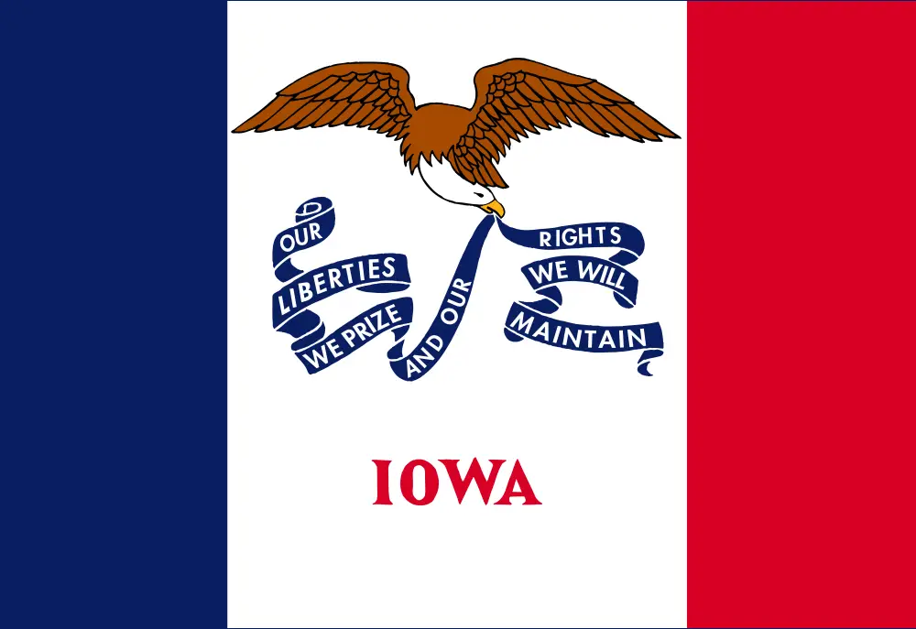
Iowa Liquor Sales
Team 3:
Katherine Belknap
Wethanie Law
Hsiu-Ping Lin
Shreyas Belur Manjunatha Swamy

Slide 2
Agenda
Data and Server Specifications
Project Architecture and Workflow
Explanation of the Project Idea
Data Validation
Exploratory and Descriptive Analysis
Geo Spatial Visualization

Slide 3
Data/Server Specifications

Slide 4
Data Set Information
Data set name: iowa-liquor-sales-20230401
Data size: 6.35GB
Total number of columns: 24
Total number of rows: 51,073,630
Data Source URL: https://www.kaggle.com/datasets/wethanielaw/iowa-liquor-sales-20230401?resource=download&select=Iowa_Liquor_Sales.csv

Slide 5
Server Specifications
Cluster version: Hadoop 3.1.2
Apache Hive (version 3.1.2)
Hive JDBC (version 3.1.2)
Beeline version 3.1.2 by Apache Hive
CPU speed: 1995.312 MHz
Number of CPU cores: 8
Number of nodes: 5 nodes
2 Master, 3 Work
Memory size: 390.7G

Slide 6
Architecture & Workflow

Slide 7







Project Architecture
Data Source
Analysis Preparation
Validation & Analysis
Analysis Download
Visualization

Slide 8




Project Workflow
Sourcing
Iowa Liquor Sales Data Set
Preparation
- Upload with scp
- Unzip
- Mkdir
Validation & Analysis
- Table
- Queries
Download
-scp
Visualization

Slide 9




Explanation of the Project Idea
Tracking liquor sales is an essential part of regulating the sale and consumption of alcohol in Iowa.
It helps ensure that the state's alcohol industry operates safely and responsibly.
help prevent underage drinking and other alcohol-related problems

Slide 10
Data Queries
Temporal Analysis
Sales trend in dollars versus liters sold
General sales trend over the years
Sales trend versus population change
Spatial Analysis
Total liters sold by county
Trend for the top 5 counties by liters sold
Geo Spatial Analysis
Sales in top County

Slide 11
Creating the Table

Slide 12
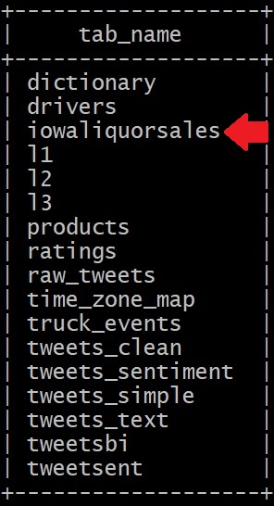
Creating Table iowaliquorsales
Create external table from data set
Using the SERDE function will create a table with all data types defaulted to the STRING data type
Create another table from new table created
Using the cast function, the data can be translated into the desired data type
ROW FORMAT SERDE
'org.apache.hadoop.hive.serde2.OpenCSVSerde'
WITH SERDEPROPERTIES ('separatorChar' = ',',
'quoteChar' = '"', 'escapeChar' = '\\' )

Slide 13
Table Column Information
Column Name | Data Type | Column Name | Data Type
invoice/item number | STRING | vendor number | INT
sales date | DATE | vendor name | STRING
store number | STRING | item number | INT
store name | STRING | item description | STRING
address | STRING | pack | INT
city | STRING | bottle volume ml | INT
zip code | STRING | state bottle cost | DECIMAL (10,2)
longitude | STRING | state bottle retail | DECIMAL (10,2)
latitude | STRING | bottles sold | BIGINT
county number | INT | sale in dollars | BIGINT
county | STRING | volume sold in liters | BIGINT
category | STRING | volume sold in gallons | BIGINT
category name | STRING | location | STRING

Slide 14
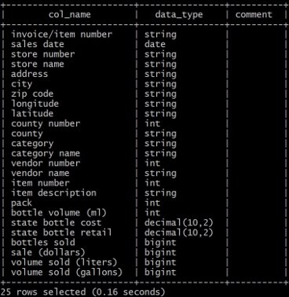
New iowaliquorsales Table
DROP TABLE iowaliquorsales;
ALTER TABLE iowaliquorsales2
RENAME TO iowaliquorsales;
DESCRIBE iowaliquorsales;

Slide 15
Exploratory/Descriptive Analysis

Slide 16
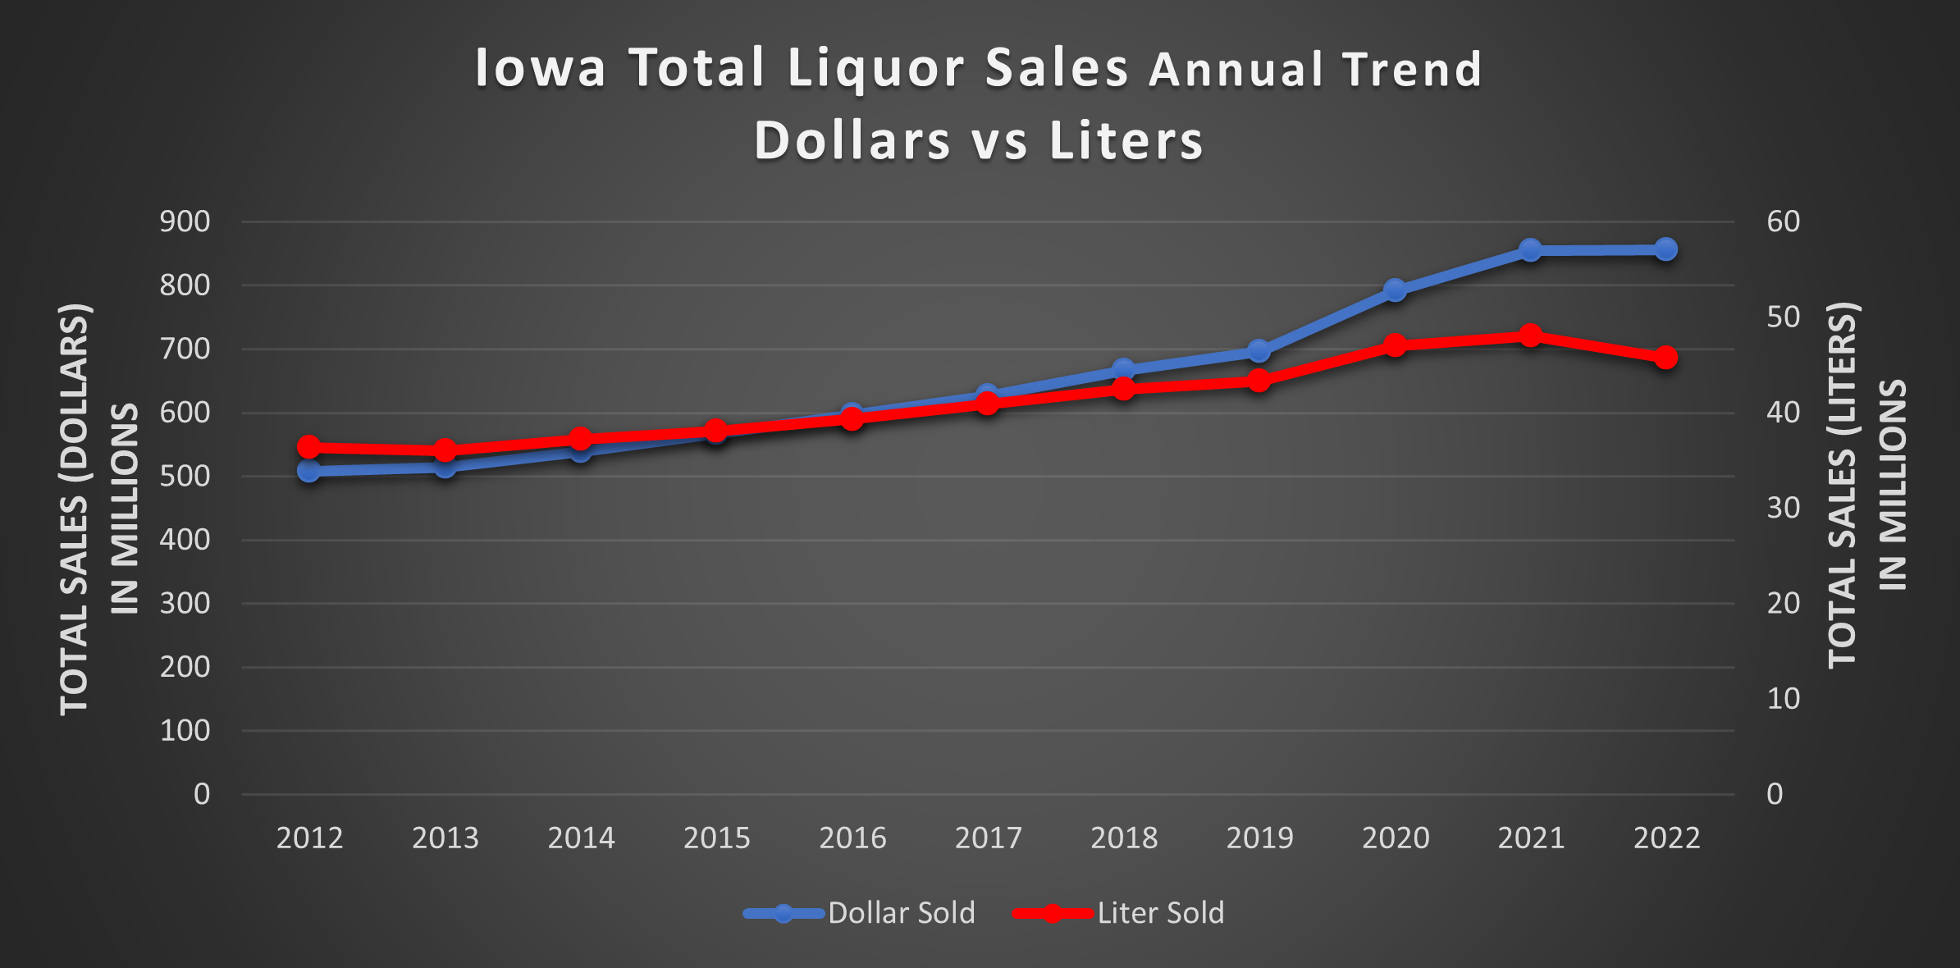

Slide 17
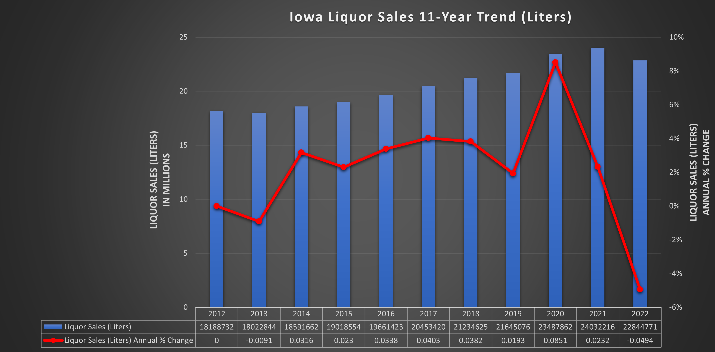

Slide 18
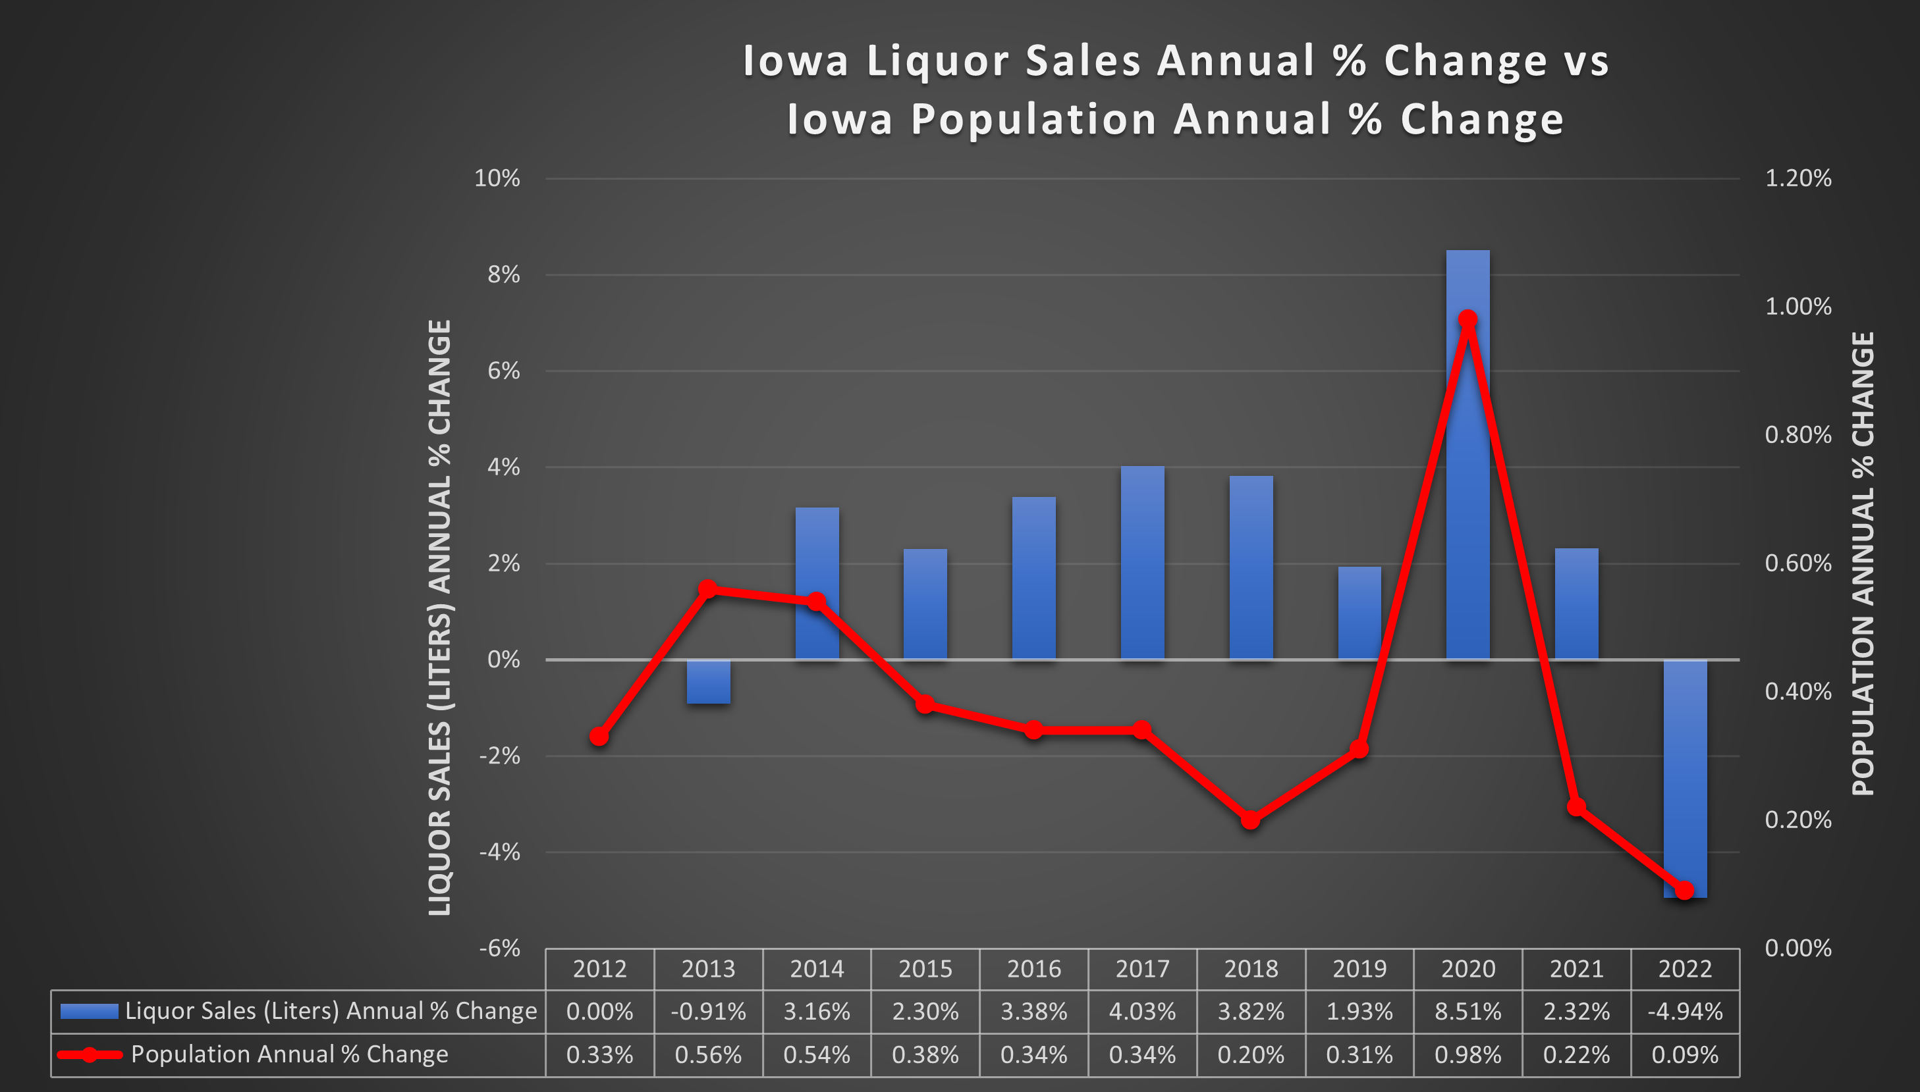

Slide 19
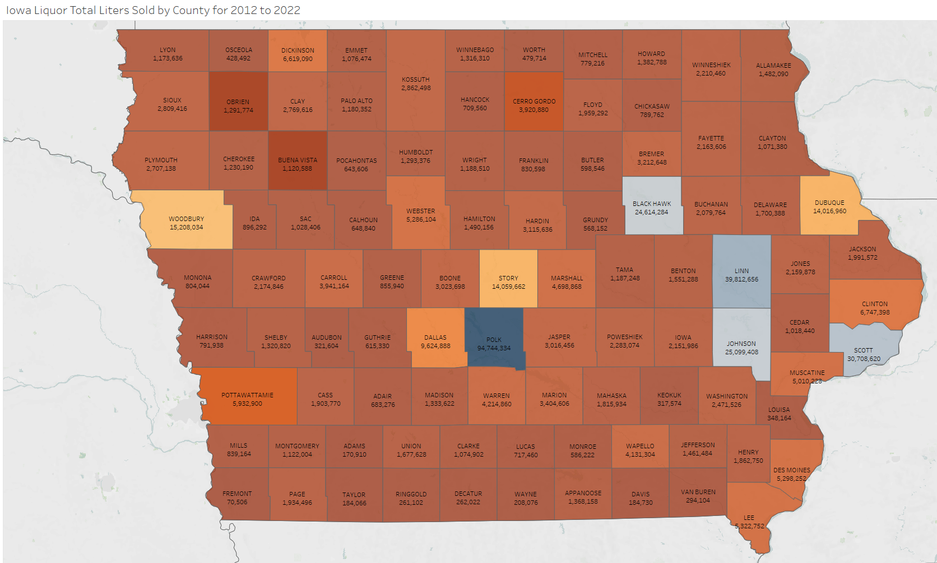
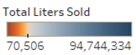
Total Liters Sold by County

Slide 20

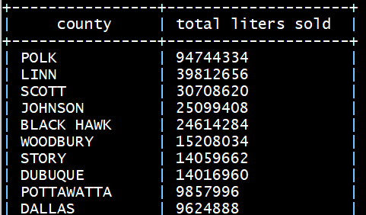
Top 5 Total Liters Sold by County
The most populous county in Iowa is Polk County
Home to the state capital, Des Moines.
According to the 2020 United States Census Polk County had a population of 498,823

Slide 21
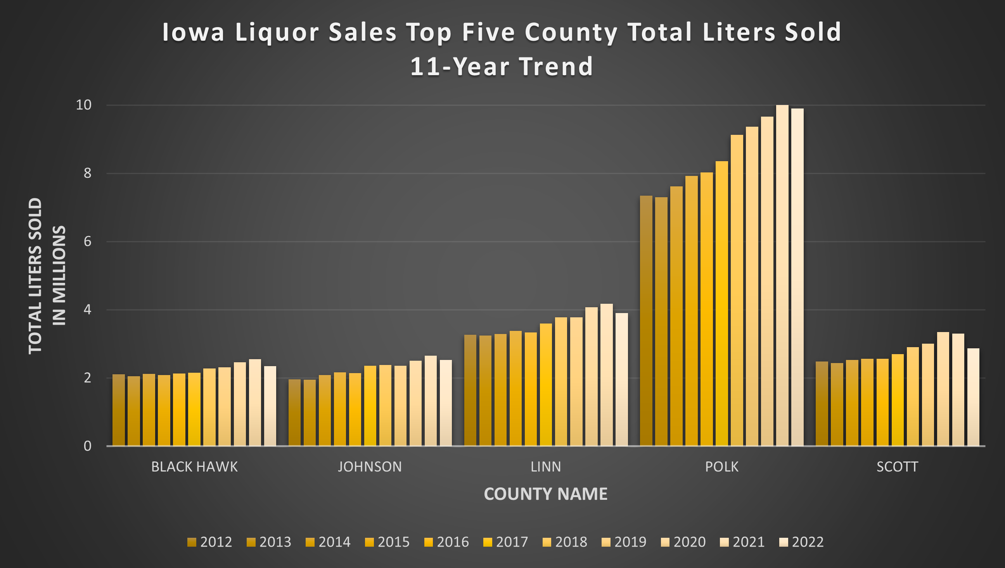

Slide 22
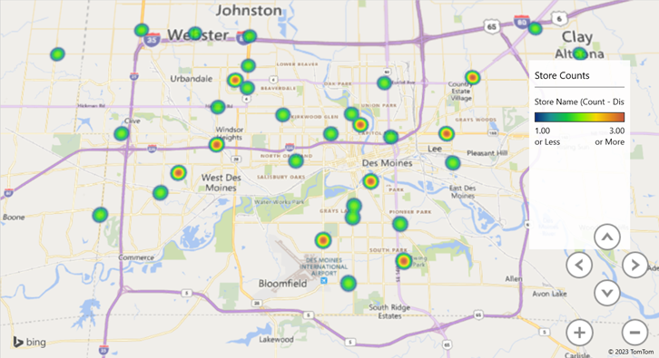
Polk County – Store Count

Slide 23
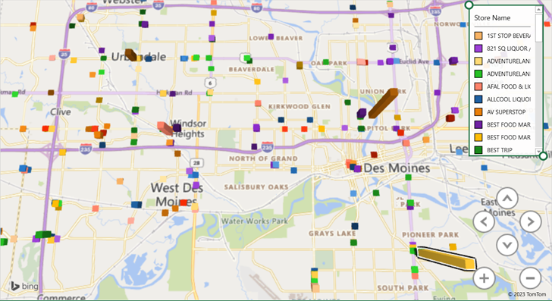
Polk County Total Liters Sold by Store

Slide 24
Top Drinking Holidays by Total Drinks Consumed
Mardi Gras
New Year's Eve
St. Patrick's Day
Fourth of July
Halloween
Cinco De Mayo
Memorial Day
Labor Day
Winter Holidays
Thanksgiving
Alcohol.org arrived at these results by polling over 1,000 Americans about their drinking habits around the holidays.
https://www.findmeabrewery.com/drinking-holidays/

Slide 25
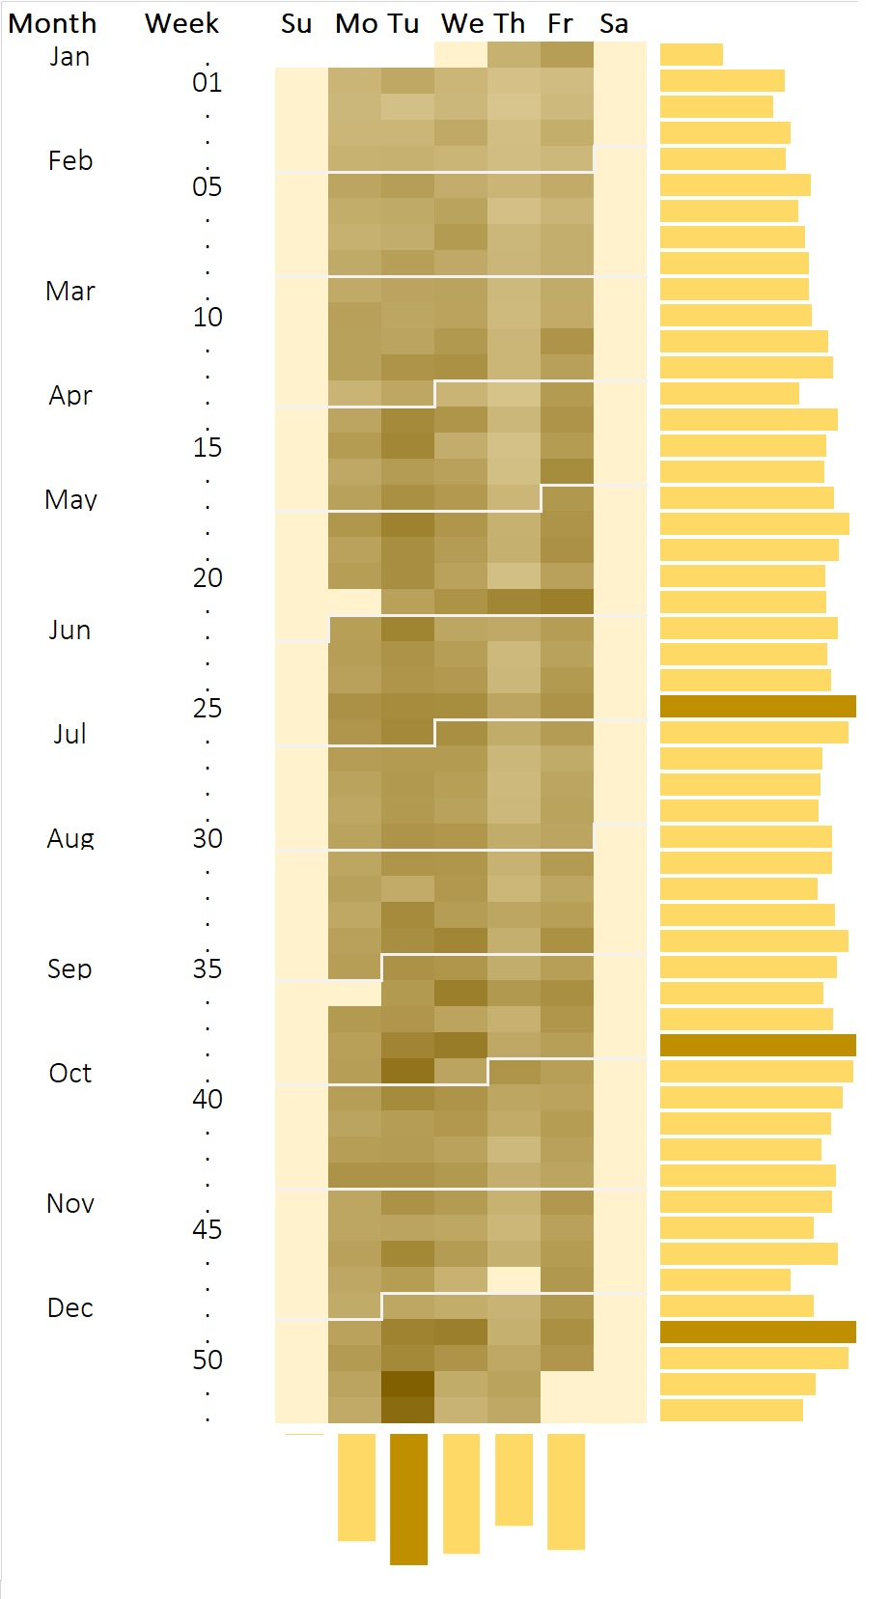
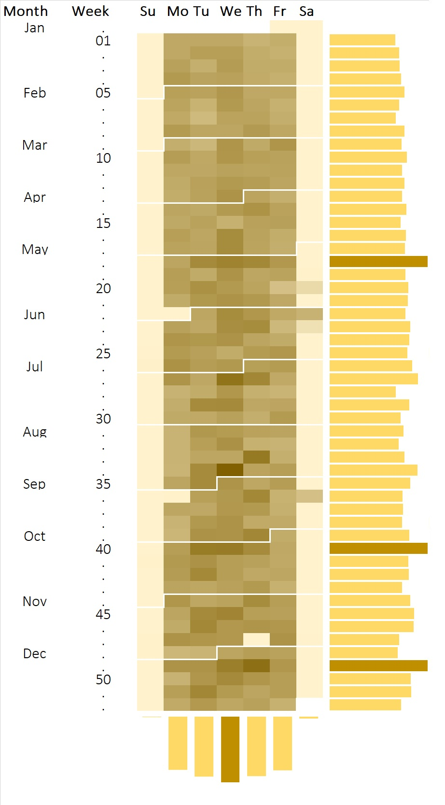
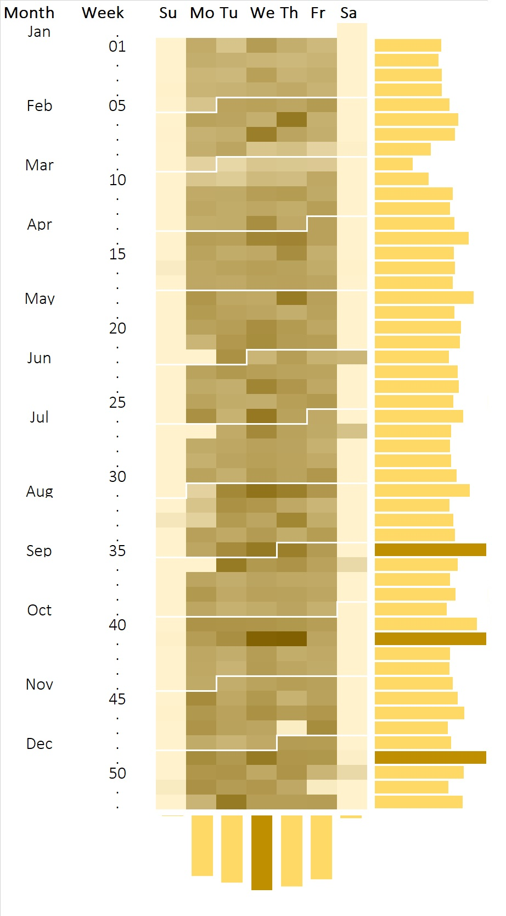
Heat Map
2020
2021
2022

Slide 26
Conclusions
Sales trends by liters are fairly consistent across counties
Polk county had the top sales, which made sense as the home of the state capital
We expected alcohol sales to corelate more with holidays, however, other than the 49th week we do not see much change

Slide 27
References
URL of Data Source
https://www.kaggle.com/datasets/wethanielaw/iowa-liquor-sales-20230401?resource=download
URL of your Github
https://github.com/lovekangaroo/IowaLiquorSales
URL of References
https://www.macrotrends.net/states/iowa/population
https://www.findmeabrewery.com/drinking-holidays/

Slide 28
Questions?

